Slide 1
Sky Net
Developing and fielding secure AUAV systems for critical mission operations in hostile arenas.
December 9, 2021
Group: FIT

Slide 2
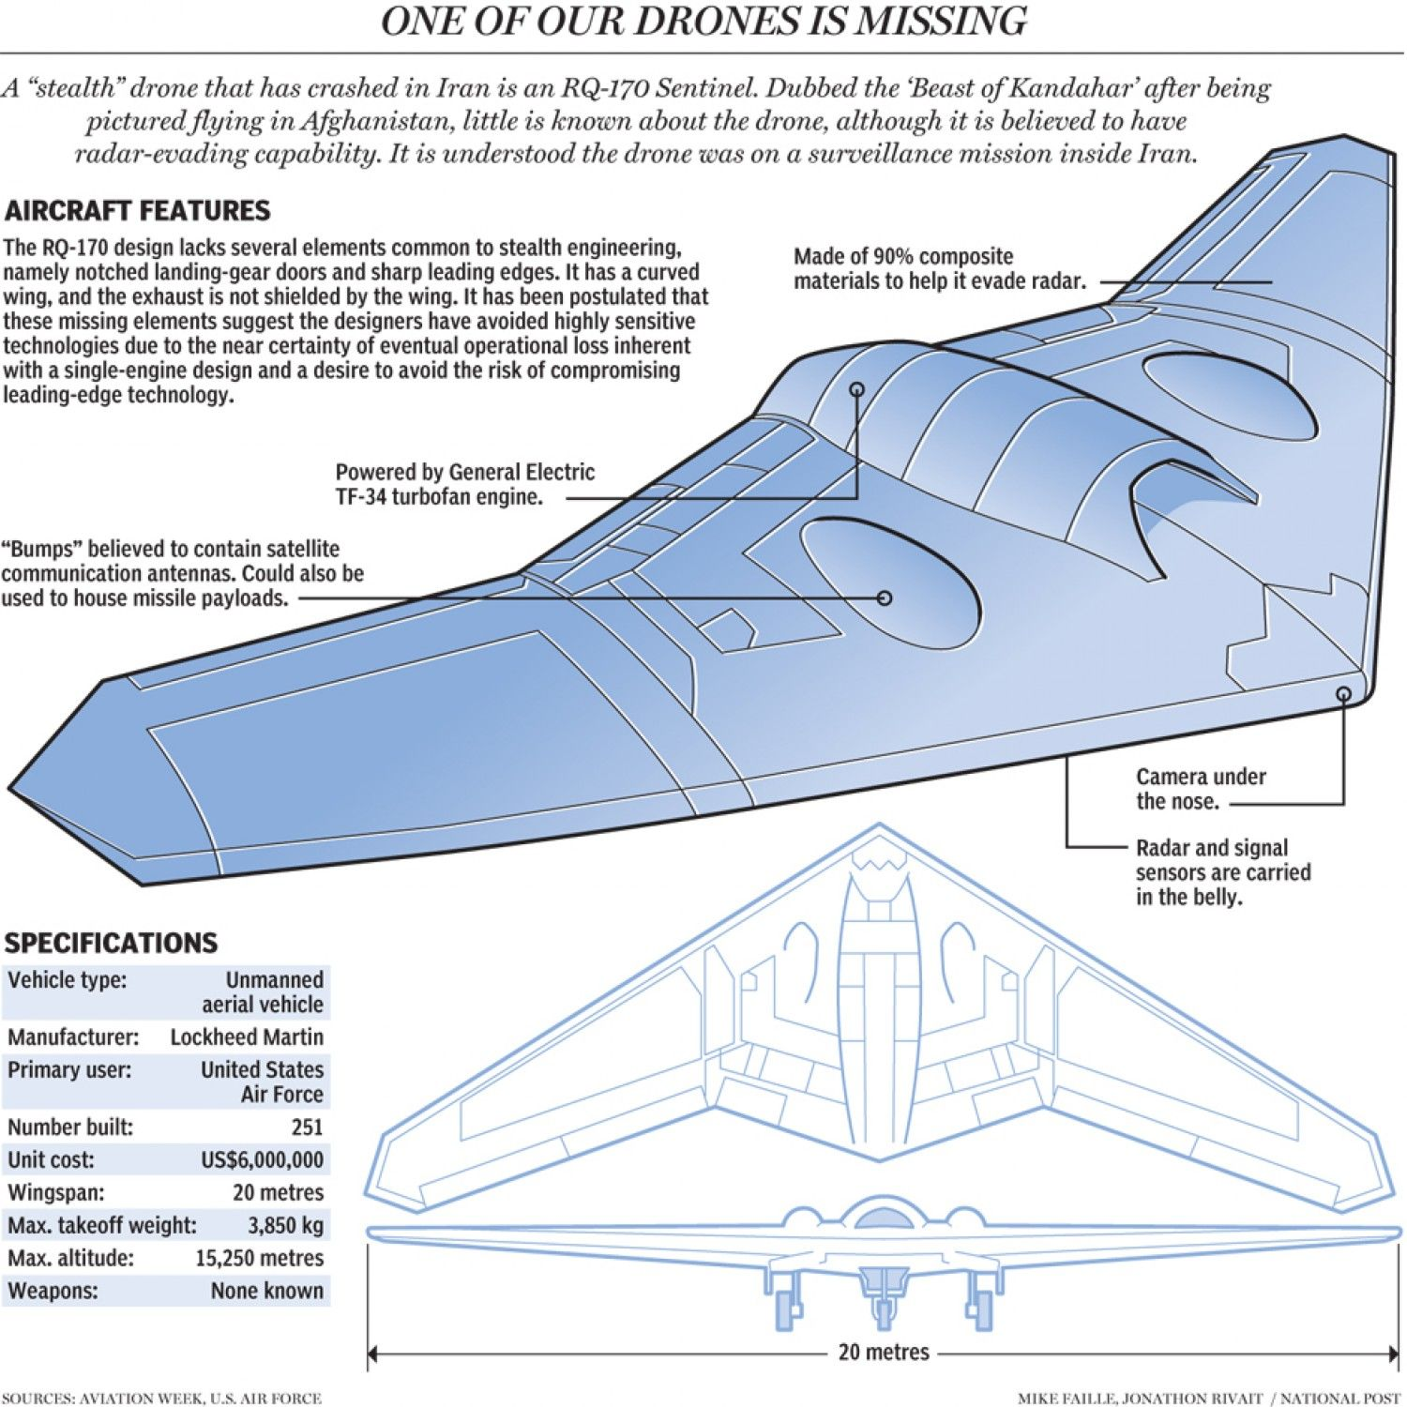
Introduction and Historical Background
A secure system is one that can successfully complete its missions while protecting against threats and attack.
On December 5th, 2011 a U.S. RQ-170 drone was lost during a reconnaissance mission near the border of Iran and Afghanistan. Theory is that the aircraft control was lost due to GPS spoofing from Iranian hackers.
There is a need for cost efficient, reliable, and secure AUAV systems to provide world-wide deployable, surveillance support for various international organizations.

Slide 3
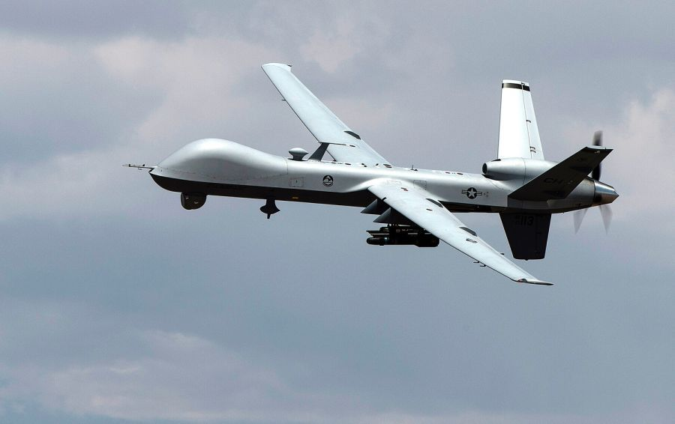
Mission and Goals
The mission is to provide multi-purpose surveillance support for worldwide scientific collection activities, support low-profile data and information collection efforts for allies and national partners, conduct rapid worldwide deployments and surveillance activities in support of national treaty monitoring interests, and implement surveillance and reconnaissance missions for national strategic and tactical targets of interest (TOIs).
The goal of this program is to provide an integration of imaging capabilities that looks like a generic ‘search-and-rescue’ AUAV that is world-wide deployable, adaptable to work in very harsh environments, and with the ability to protect itself. It shall provide both AI-based autonomous and remote control capabilities as well be used individually or as part of an integrated swarm of AUAVs. Also to offer features like voice control, digital signal processing and power/energy support system for the mobile command center.

Slide 4
Technical details
Optical Atmospheric Turbulence Compensating (ATC) imaging and General Purpose Parallel Processing (GPPP) technology for rapid filter/transform/inverse-transform applications
Compensating imaging capability, ATR and digital signal processing
Providing fastest (real-time) and highest spatial resolution
Ability to discriminate between human and wildlife; day or night
Continuous awareness of environment and surroundings
Object of Interest (OoI) tracking
Autonomous flight with Search-and-Find maneuvers
Remotely Controlled by a Mobile Command Center (MCC)
Data stream provided to the flight computer
Autonomous Individually or Part of an Integrated Swarm
Autonomous operations controlled by the flight computer directly (autonomous mode)
Flight computer monitoring (GPS fence, proper flight attitude, altitude monitoring, etc)
Flight computer analysis & summary data sent to command center (manual control mode)
Adaptive, AI-based decision-making/mission reconfiguration
Adaptability for other features/capabilities/sensor packages/upgrades
AI-based voice control

Slide 5
Discriminators
Technical discriminators
Leveraged cots components
This system includes the following unique features that sets our solution above the competitors:
Custom algorithm for combining Inertial Measurement Unit (IMU) and GPS data
Seamless switchover between primary & secondary sensors
Security framework for verifying GPS integrity
Low Swap NSA certified encryption for data
Protected against EW jamming/spoofing operations
Capability of autonomous flight with Artificial Intelligence (AI) - based decision-making for station-keeping, threat-aversion, "search and find" maneuvers and Object of Interest (OoI) tracking.
Can be used individually or as part of an autonomous, integrated swarm (AIS) of AUAVs, with adaptive, AI-based decision-making/mission reconfiguration.
The following COTS components are used to reduce cost and schedule for the program while meeting our technical requirements:
Protected GPS receiver
IMU sensor
Data & command processors
Optical sensor/detector

Slide 6
Key Contributors and References
Key Contributors
References
Futuristic Innovative Technologies
NavSys Corporation
Shadin Avionics
Northrop Grumman
AUAV Navigation
General Atomics
A. Brown and H. Tseng, “Miniaturized GPS Antenna Array and Test Results”, NavSys Corp, 2000
“Inertial Navigation System” from Space Microsystems and Micro/Nano Satellites, 2018 ScienceDirect Journal www.sciencedirect.com/topics/engineering/inertial-navigation-system
https://www.AUAVnavigation.com/products/autopilots/vector
https://fpvfrenzy.com/best-obstacle-avoidance-drones-features-technology-reviews/
https://ieeexplore.ieee.org/abstract/document/7943915
"Spatial resolution in digital imaging"
https://www.microscopyu.com/tutorials/spatial-resolution-in-digital-imaging
"Swarm of Unmanned Aerial Vehicles"
https://www.sciencedirect.com/science/article/pii/S2452414X18300086

Slide 7
Challenges and Roadblocks
Miniaturization due to limited size constraints for UAV.
Fitting within stealth profile for radar evasion.
Functioning in a contest environment with signal jamming and interactions with other aerial systems.
Integration as a retrofit onto an existing platform
Custom processor code to seamlessly combine the sensor data streams
Leveraging COTS hardware and software to reduce schedule and cost
Ethical use of AI technologies in AUAV applications.
Provide renewable energy source for the mobile command center worldwide deployable.

Slide 8
Stakeholders
Primary Stakeholders | Secondary Stakeholders
Point-of-Contact: U.S. Department of Homeland Security and the U.S. Customs and Border Protection Chief of Operations Wilford Erasmus. | Other Stakeholders Government National Security Agencies (HSBP, FBI, CIA, ATF, DEA, DIA, US Marshals Service, Local Law Enforcement, etc.) First Responders (U.S. and International Search and Rescue) U.S. Coast Guard National Park Service Aid Organizations Interpol Embassies National Society of Professional Surveyors Environmental and Ecological Organizations International Universities International Research Organizations International Air and Space agencies US Allies and Partners US Military AFRL and Air Force Life Cycle Management Center (AFLCMC)
The Customer: Unnamed 3-letter agency represented by Wilford Erasmus.
The Hands-On Users AUAV Flight Officer AUAV Optical Operator AUAV Intelligence Officer AUAV Maintenance Technicians UAS Maintenance Technicians

Slide 9
Stakeholder Needs
After discussions with the primary stakeholders, customer and client, several needs were identified:
Provide an Atmospheric Turbulence Compensating (ATC) imaging system with General Purpose Parallel Processing (GPPP) technology for rapid filter/transform/inverse-transform applications that provides the fastest (real-time), and highest spatial resolution images available.
Capabilities of autonomous flight with Artificial Intelligence (AI) - based decision-making for station-keeping, threat-aversion, “search and find” maneuvers and Object of Interest (OoI) tracking.
Ability to be used individually or as part of an Autonomous Integrated Swarm (AIS) of Autonomous UAVs with adaptive, AI-based decision-making/mission reconfiguration.
Adaptability for other features/capabilities/sensor packages (e.g. natural language, AI-based Command and Control Interface).
a component-level detailed bottoms-up analysis for the power/energy support system for the mobile command center

Slide 10
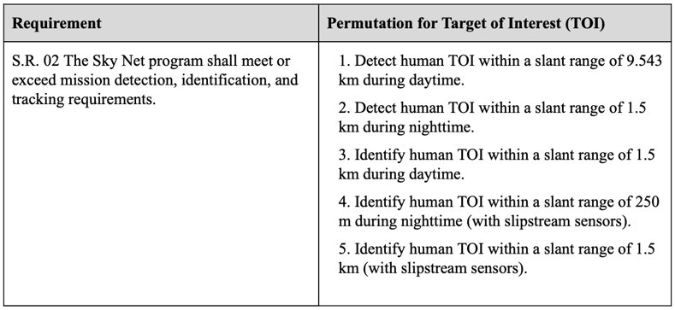
Stakeholder Requirements
S.R. 01 The AUAV system shall interface with the existing AUAV mission control center to provide the best possible imaging technology and data processing for detection, identification, and tracking capabilities.
S.R. 02 The Sky Net program shall meet or exceed mission detection, identification, and tracking requirements as specified in Table 3 Permutation of Stakeholder Requirements (Table shown below).
S.R. 03 The AUAV shall conduct its operations in a safe manner.
S.R. 04 The AUAV shall have a flexible control scheme through either a remote mission control center, local mobile command center, or independent A.I. based decision-making system; with the ability to exchange authority over the AUAV between all control methods.
S.R. 05 The AUAV shall be adaptable for other features/capabilities/sensor packages/upgrades including a natural language, AI-based decision-making/mission reconfiguration.
S.R. 06 The AUAV should utilize commercial off the shelf products (COTS) where possible to reduce risk and cost.
S.R. 07 The AUAV shall be capable of supporting 24/7 operations worldwide.
S.R. 08 The AUAV shall be supported and maintained throughout the program’s lifecycle over 25 years after delivery with pre-planned program improvements.

Slide 11
Stakeholder Requirements
S.R. 09 The AUAV shall have an operational availability of at least 98%.
S.R. 10 The AUAV shall have an instantaneous reliability of at least 70%.
S.R. 11 The AUAV shall have a Mean time between failures (MTBF) of 20 years.
S.R. 12 The AUAV shall have a Mean time to repair (MTTR) of less than 8 hours.
S.R. 13 The AUAV shall be capable of performing solo missions with the aid of the onboard AI system.
S.R. 14 The AUAV shall be capable of flying as a part of an integrated swarm of AUAVs with adaptive, AI-based decision-making/mission reconfiguration.
S.R. 15 The integrated swarm of AUAVs shall be able to cooperatively intercept and geolocate Objects of Interest (OoI).
S.R. 16 The AUAV shall be capable of sending critical information to the Mission Command Center in less than 5 seconds.
S.R. 17 The mobile command center should have a consistent and reliable power source that is capable of supplying 10kW hr to 20 kW hr per day to the MCC.
S.R. 18 The system shall be able to operate in harsh and extreme environments.
S.R. 19 The AUAV system must look like a benign Search and Rescue AUAV.

Slide 12
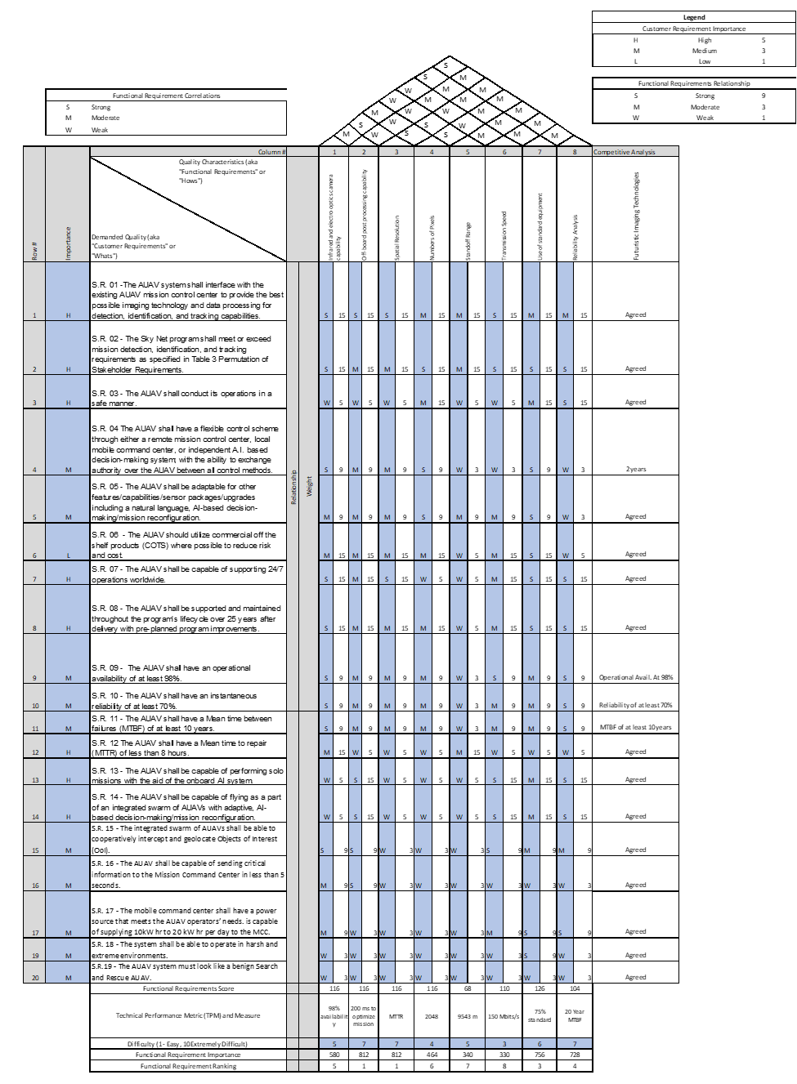
Quality Functional Deployment (QFD)
A modified Quality Functional Deployment (QFD) was developed to capture the critical aspects of the Stakeholder Requirements and to give a visual representation of the technical responses for these driving requirement.
As a result, this will help provide a quantitative value to the requirements (functional and stakeholder)
Each stakeholder requirement was given an importance value determined by how crucial it was to the projects needs and functions.
The values are multiplied to give a functional requirement score which is then multiplied again by a degree of difficulty factor.
The final score is the functional requirements importance and ranking.
Link to QFD
Notes:
Click here to access more detailed version of QFD in supporting information. Link to QFD

Slide 13
Concept of Operations
The CONOPS focuses on the AUAV as it monitors a search area associated with a hot spot, operated as part of an autonomous system, on as part of an autonomous integrated swarm (AIS) of AUAV within designated, world-wide area of operations.
This intelligent AUAV system is designed to be a search and rescue AUAV.
This system is capable of interacting with U.S. internal agencies and external allies, strategic partners using a voice-based AI capability.
The AUAV has an AI-based decision-making capability with manual override and is capable of advance (Signal/Image Processing) such as automatic target recognition and real time atmospheric turbulence compensation.
The AUAV system can conduct Object of Interest tracking and can be controlled by its internal AI system.
The system has a Mobile Command Center (MCC) that can be deployed indefinitely in remote, low access areas and it will be powered up by a quiet and renewable energy source.

Slide 14
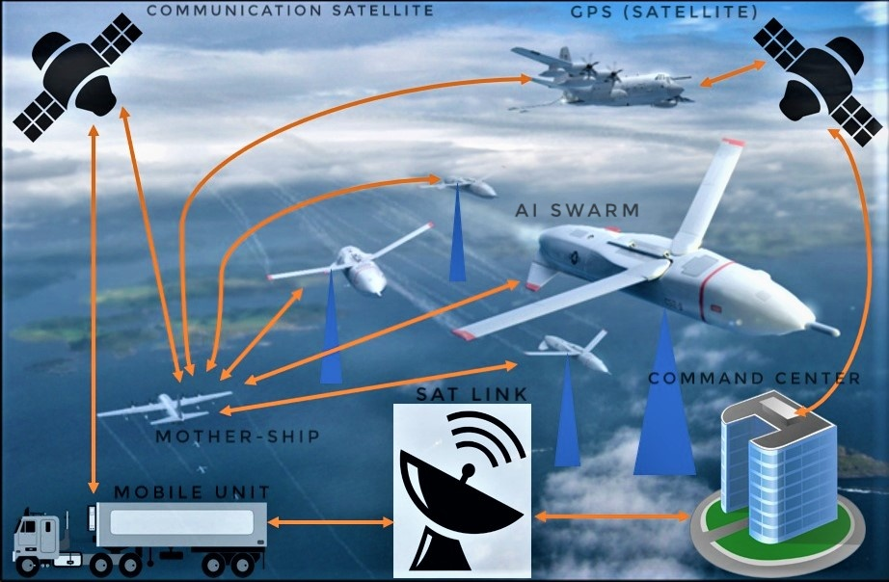
Concept of Operations (Cont.)

Slide 15
Scope
The project scope is to integrate state-of-the-art ATC imaging capabilities with General Purpose Parallel Processing (GPPP) technology in real time, perform “search and find” maneuvers, object of interest tracking, and threat aversion; operate both independently and as an autonomous integrated swarm of AUAVs with adaptive, AI-based decision-making/mission reconfiguration; and is adaptable for future features such as natural language, AI-based Command and Control Interface. and compensate for atmospheric turbulence imaging distortion and automatic target recognition.
FIT will also create a feasibility study for the development of an energy support system for the Mobile Command Center (MCC), which will have the capability to be deployed indefinitely in remote low access areas.

Slide 16
Goals and Objectives
The goal is to provide a feasibility study of a set of several highly specialized features/capabilities for a potentially new AUAV for a three-letter national agency within a 16-week period. The customer also has asked for a set of baseline documentation and associated artifacts.
Finally, the customer has funded FIT for an energy feasibility study for a Mobile Command Center that can be indefinitely deployed in a remote, low access area.
The business goal is to increase the market share of Futuristic Innovative Technologies by 15% within 5 years by developing and marketing this advanced intelligent AUAV.

Slide 17
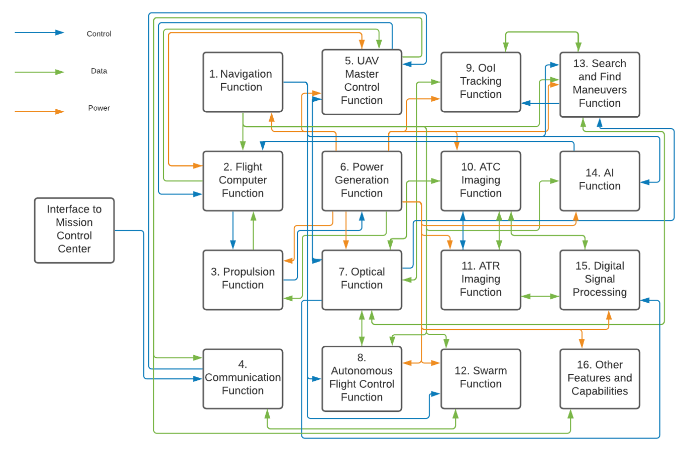
Functional Block Diagram
The focus of this project is to create a feasibility study of a set of highly technical capabilities to an existing AUAV. The high-level functional block diagram for these capabilities are shown in the following functional block diagram.

Slide 18
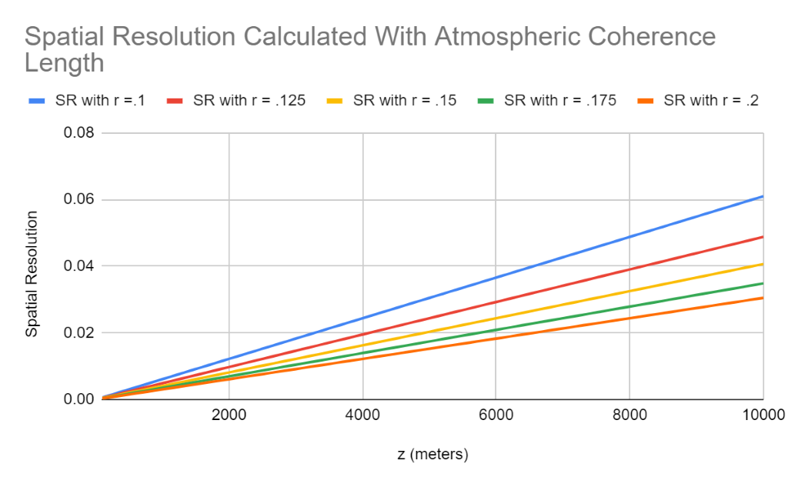
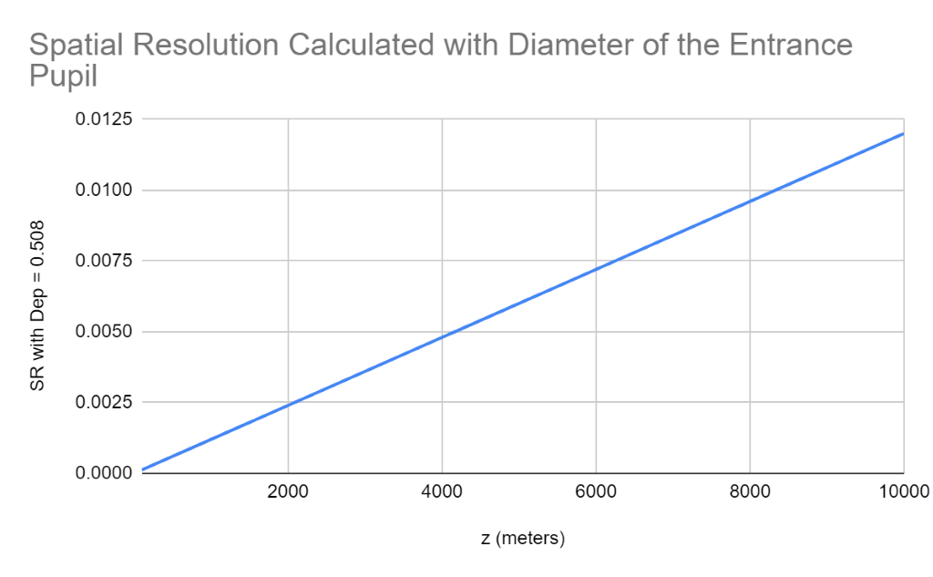
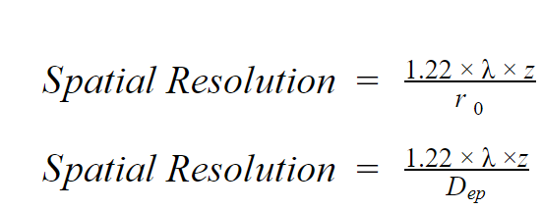
Feasibility Analysis: Spatial Resolution Requirements
Performed analysis of the project requirements for Daytime and Nighttime Identification and Detections
Calculations performed in accordance with the specified distances that the AUAV would need to either Identify or Detect a human target during either the day or night
Top figure: calculating the Spatial Resolution for Circular Aperture Imaging Systems in the Atmosphere. (Top equation below)
Bottom figure: calculating the Spatial Resolution for Atmospheric Turbulence Corrected Imaging Systems. (Bottom equation below

Slide 19
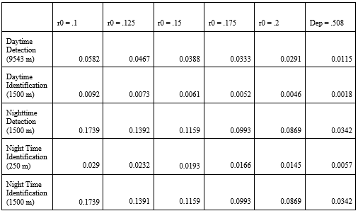
Feasibility Analysis: Spatial Resolution Requirements
The purpose of this feasibility study is to determine if the AUAV can detect and/or identify a human from different ranges and light conditions during its operation. For the Spatial Resolution Values in the table below, the detection of a human in daytime and nighttime fall into the range of less than or equal to 0.2 m

Slide 20
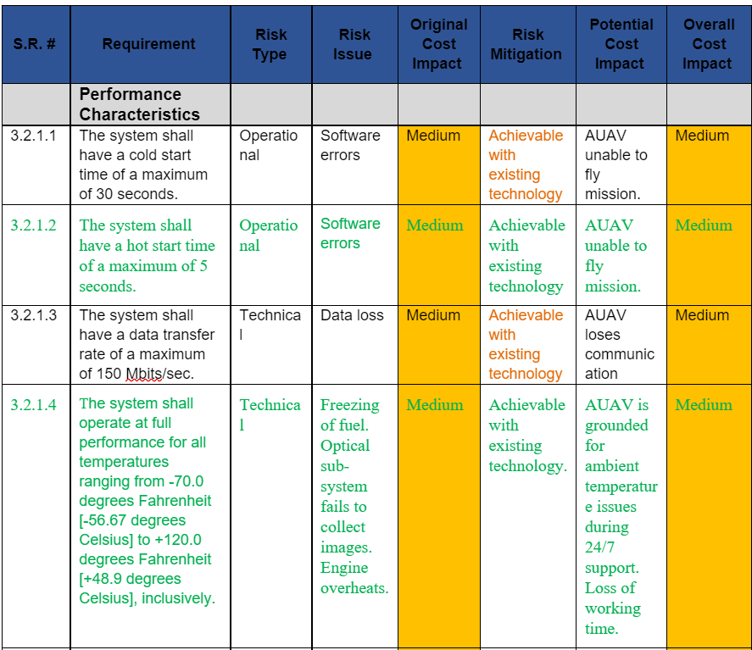
Feasibility Analysis (System Requirements)
Following table contains a sample of the feasibility analysis performed on the performance characteristics of the system level requirements.
It represents the analytical results for each requirement with risk to assess if the requirement is feasible based on the perspective of cost, performance, technical, security, or operational impacts.
Main output suggests that with risk mitigation, no requirements fall into the High Overall Cost Impact zone. With the use of safety measures to prevent harm or damage to personnel, the AUAV, and data tampering, it is feasible to operate.
Specifications based on a real system of the General Atomics MQ-1 Predator also verified that weight and size requirements can be met as well.
The full tables can be found in the Supporting Documentation here.

Slide 21
Analytic hierarchy Process (AHP)
The goal of the Analytic Hierarchy Process is to help FIT select the technical feature “optical sensor/detector” for the AUAV from a set of three alternatives based on the importance values of certain criteria.
Table: Alternatives for the optical sensor/detector
Alternative 1 (“A”) | Alternative 2 (“B”) | Alternative 3 (“C”)
High Spatial Resolution Sensor | Multispectral Camera | Polarimetric Camera
Importance Scale | Definition of Importance of Scale
1 | Equally Important
2 | Equally to Moderate Important
3 | Moderately Important
4 | Moderately to Strongly Important
5 | Strongly Important
6 | Strongly to Very Strongly Important
7 | Very Strongly Important
8 | Very Strongly to Extremely Important
9 | Extremely Important
Table: Definition of Importance
Criteria | Importance Scale
Maintenance/Support | 7
Reliability | 8
Material Discrimination | 4
Cost | 6
Spatial Resolution | 5
Weight | 3
Table: Score for the Importance of factors

Slide 22
Analytic hierarchy Process (AHP) (Continued…)
Table: Estimated parameter comparison values (preference matrix
 | Maintenance/ Support | Reliability | Material Discrimination | Cost | Spatial Resolution | Weight
Maintenance/ Support | 1 | 1/4 | 2 | 1/2 | 1/3 | 2
Reliability | 4 | 1 | 8 | 6 | 4 | 7
Material Discrimination | 1/2 | 1/8 | 1 | 1/4 | 1/3 | 1/2
Cost | 2 | 1/6 | 4 | 1 | 1/3 | 4
Spatial Resolution | 3 | 1/4 | 3 | 3 | 1 | 2
Weight | 1/2 | 1/7 | 2 | 1/4 | 1/2 | 1

Slide 23
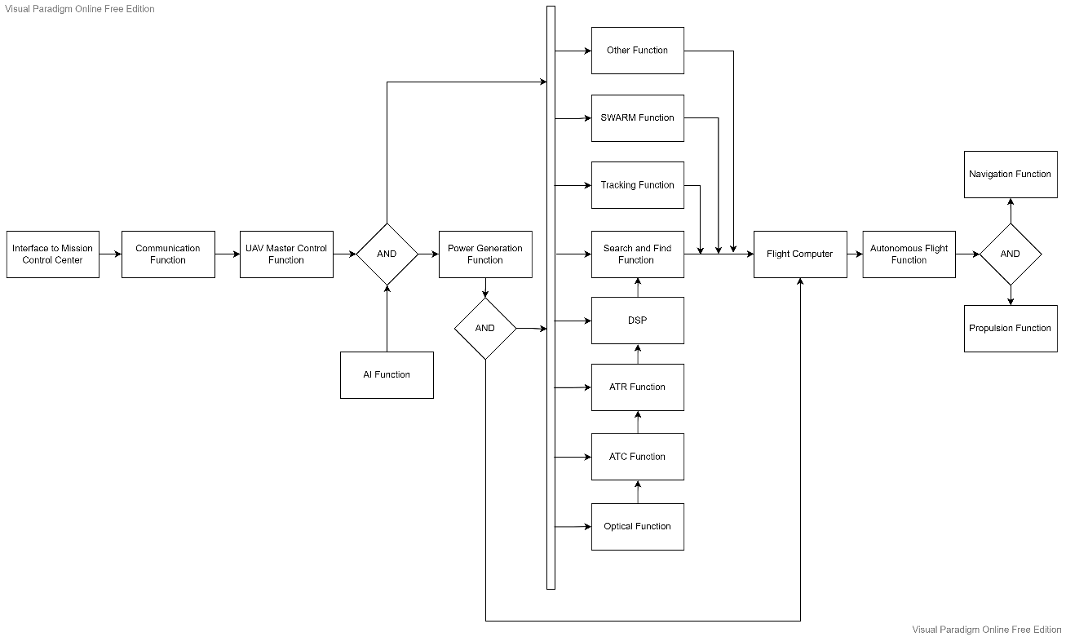
Functional Flow Diagram
The preliminary design phase expands on the function flow diagrams developed in the conceptual design

Slide 24
Reliability Model and Analysis
Mean Time Between Failure (MTBF) data was found for representative components of the Inertial Measurement Unit, GPS, and Processors.
The MTBF for the Power Distribution Unit (PDU) was not found but an estimated value of 128,000 hours was used.
The software was intentionally left out of the model as it is expected that after operational acceptance the source code will not be subject to development.
The software is specific to this autonomous UAV and once proven successful and complete will not be modified unless separate engineering change proposals are executed.

Slide 25
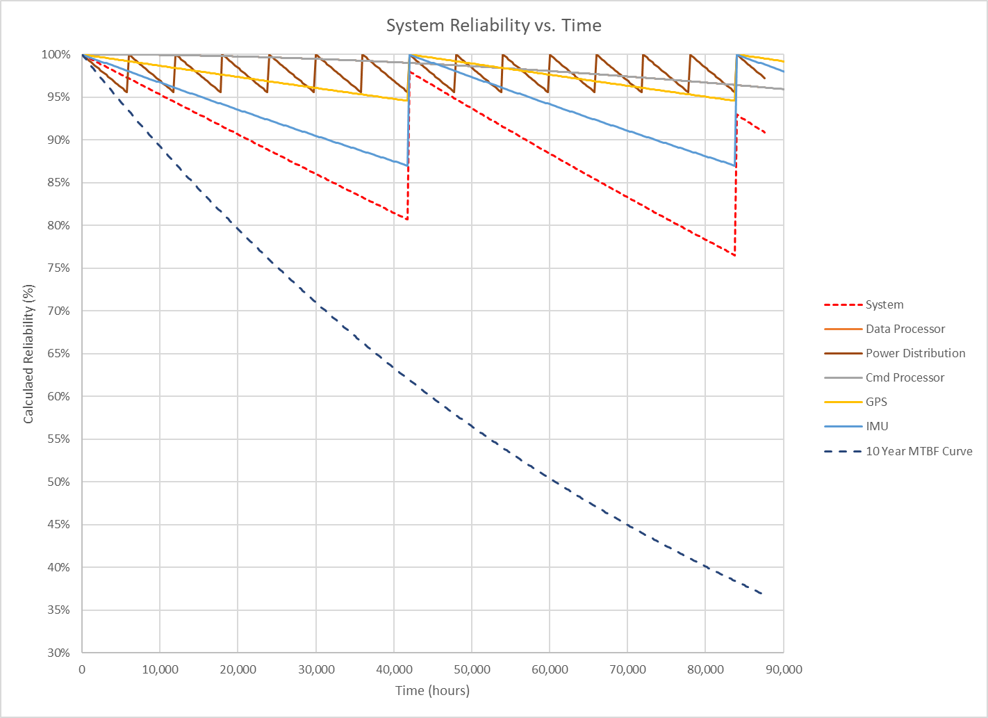
Reliability Model and Analysis
Figure represents the system reliability over the 10-year period as a function of time.
The sawtooth nature of the overall system reliability is due to the adoption of the preventative replacement policy for the components.
Should future work locate more reliable systems, they should be assessed for suitability.
This reliability analysis covers only the Navigation Subsystem.
Overall UAV reliability cannot be performed at this time due to insufficient data.

Slide 26
Commercial Off the Shelf (COTS) Products
Component | Model
Terminal Strip | Molex 9.53 [0.375] Double Row Low Profile BTS Assembly (or Equal)
Voltage Regulator | PST-DCZ0305-W 3.3 Volt Output Voltage Regulator (or Equal)
Voltage Regulator | PST-DCZ0505-W 5.0 Volt Output Voltage Regulator (or Equal)
Inertial Measurement Unit | MTi-G-710 GNSS (or Equal)
GPS Receiver | i-Lotus M12M (or Equal)
Programmable Logic Controller | Allen Bradley CompactLogix 5380 (or Equal)
ATR | Raytheon VADER
Data Storage | Seagate Expansion 4 TB STEA4000400

Slide 27
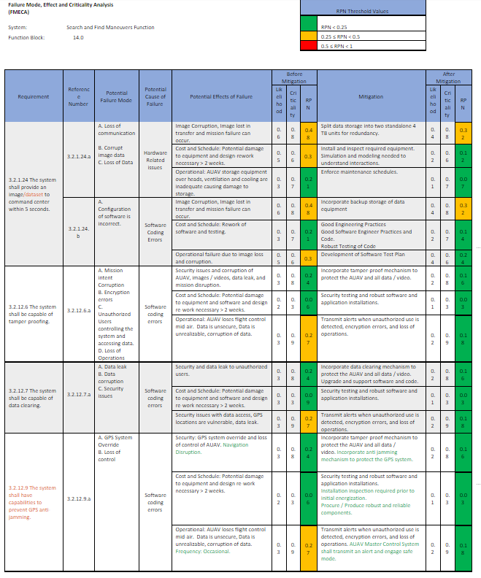
Failure Mode, Effect, and Criticality Analysis (FMECA)
The following table is an overview of the failure modes and their criticality for each functional component in the navigation subsystem of the AUAV developed by FIT. Additional tables may be found in the Supporting Documentation for greater readability and more detail here.

Slide 28
Acronyms
ATF | Bureau of Alcohol, Tobacco, Firearms
ATC | Atmospheric Turbulence Compensating
AUAV | Autonomous Unmanned Aerial Vehicle
ATR | Automatic Target Recognition
AIS | Autonomous Integrated Swarm
CIA | Central Intelligence Agency
CONOPS | Concept of Operations
COTS | Commercial Off-the-Shelf
DEA | Drug Enforcement Administration
DIA | Department of Internal Affairs
EW | Emergency Worker
FMECA | Failure Mode, Effect, and Criticality Analysis
FBI | Federal Bureau of Investigations
FAA | Federal Aviation Administration
FIT | Futuristic Innovation Technology
GPS | Global Positioning System
HSBP | Homeland Security Border Protection
IMU | Inertial Measurement Unit
MTBF | Mean time between failures
MTTR | Mean time to repair
MCC | Mobile Command Center
NSA | National Security Agency
OoI | Object of Interest
QFD | Quality Functional Deployment
SoI | Signals of Interest

Slide 29
References
[1] AUAV Navigation. n.d. <https://www.AUAVnavigation.com/products/autopilots/vector>.
[2] Brown, A and H Tseng. "Miniaturized GPS Antenna Array and Test Results." 2000..
[3] Funk, F and P Stütz. A passive cloud detection system for UAV: Weather situation mapping with imaging sensors. Big Sky, MT: IEEE, 2017. <https://ieeexplore.ieee.org/abstract/document/7943915>.
[4] Oliver. "Best Obstacle Avoidance Drones: Features, Technology & Reviews." n.d. FPV Frenzy. <https://fpvfrenzy.com/best-obstacle-avoidance-drones-features-technology-reviews/ >.
[5] Space Microsystems and Micro/Nano Satellites. "Inertial Navigation System." ScienceDirect Journal (2018). <www.sciencedirect.com/topics/engineering/inertial-navigation-system>.
[6] Spring, Kenneth R, et al. "Microscopy U." n.d. Nikon Instruments Inc. Online Document. <https://www.microscopyu.com/tutorials/spatial-resolution-in-digital-imaging>.
[7] Tahir, Anam, et al. "Swarms of Unmanned Aerial Vehicles — A Survey." Journal of Industrial Information Integration 16 (2019). Online Document. <https://www.sciencedirect.com/science/article/pii/S2452414X18300086>
Notes:
References used throughout the project development

Slide 30
Student Contribution
Name | Notes
Dylan Huss (11.12%) | All students contributed equally to the design dossier.
Bria Booth (11.11%) | All students contributed equally to the design dossier.
Suleyman Gokdemir (11.11%) | All students contributed equally to the design dossier.
Andrew Thomas (11.11%) | All students contributed equally to the design dossier.
Spenser Gorenflo (11.11%) | All students contributed equally to the design dossier.
Connor Hill (11.11%) | All students contributed equally to the design dossier.
Dhwanil Desai (11.11%) | All students contributed equally to the design dossier.
Nisarg Shaw (11.11%) | All students contributed equally to the design dossier.
Miles Medearis (11.11%) | All students contributed equally to the design dossier.
Yaya Nedd (11.11%) | All students contributed equally to the design dossier.
Mariana Villalabeitia Arenas (11.11%) | All students contributed equally to the design dossier.

Slide 31
Thank you for your time

Slide 32
Blank Slide left Intentionally

Slide 33
Backup Slides

Slide 34
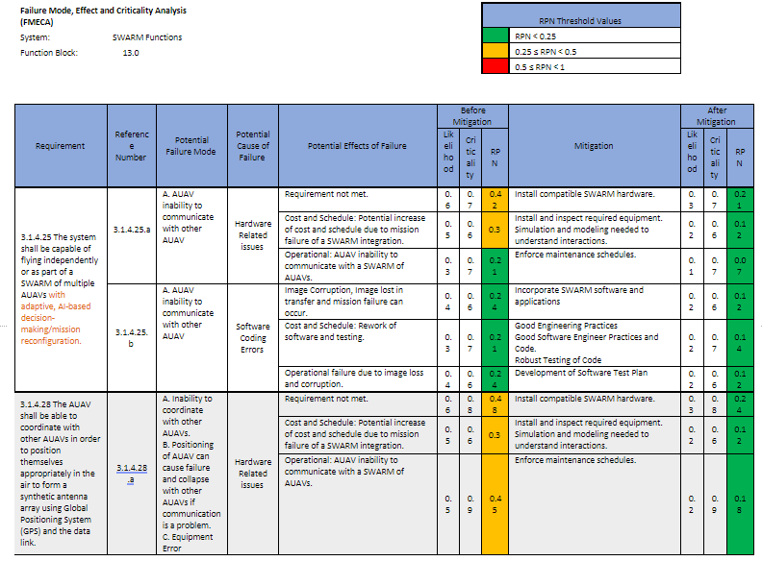
Failure Mode, Effect, and Criticality Analysis (FMECA), cont’d

Slide 35
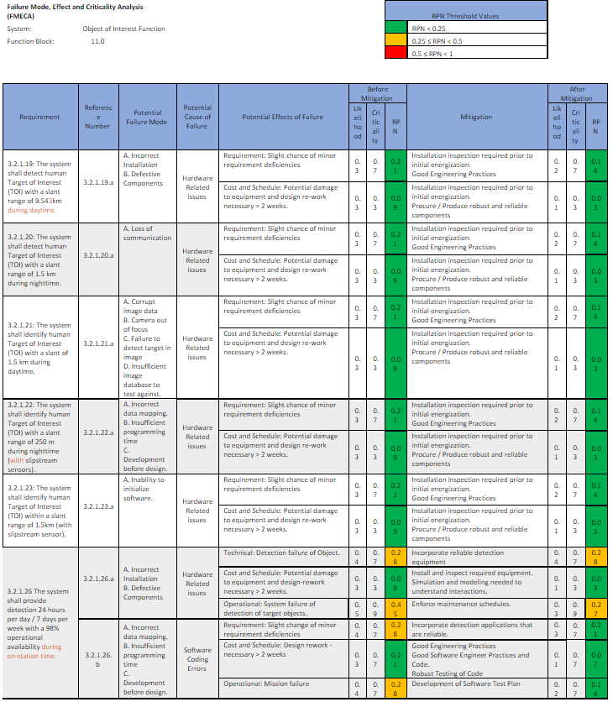
Failure Mode, Effect, and Criticality Analysis (FMECA), cont’d

Slide 36
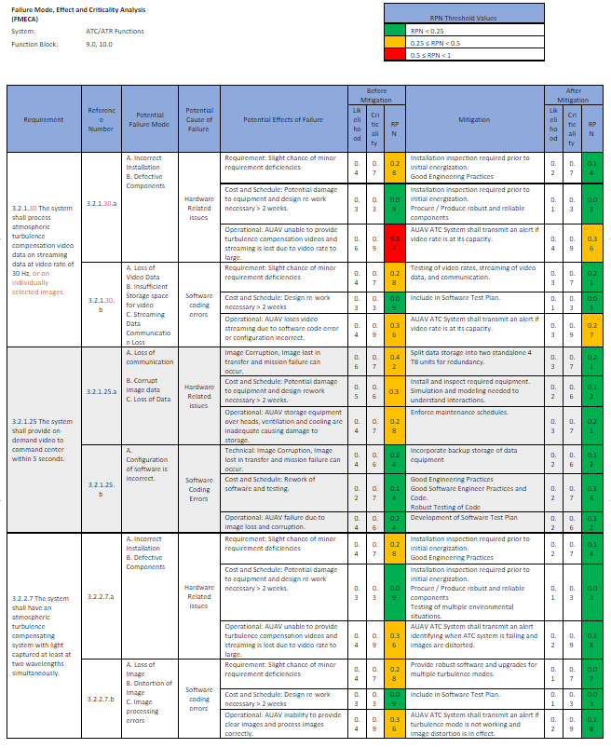
Failure Mode, Effect, and Criticality Analysis (FMECA), cont’d

Slide 37
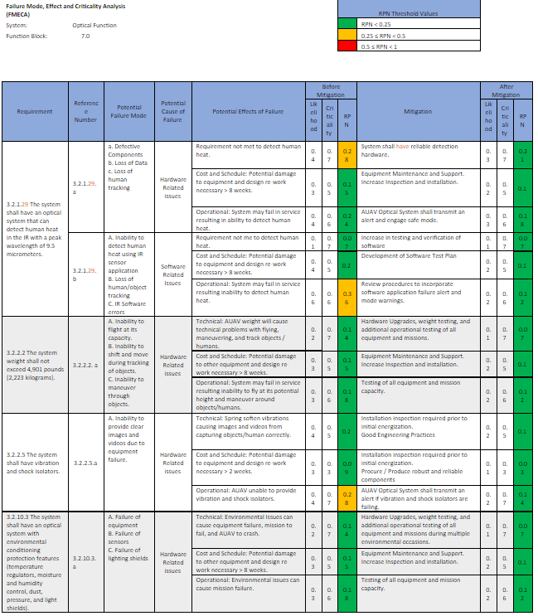
Failure Mode, Effect, and Criticality Analysis (FMECA), cont’d

Slide 38
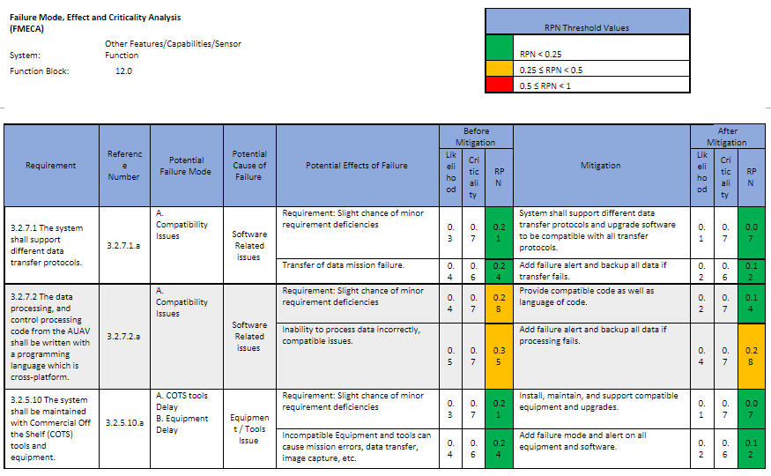
Failure Mode, Effect, and Criticality Analysis (FMECA), cont’d

Slide 39
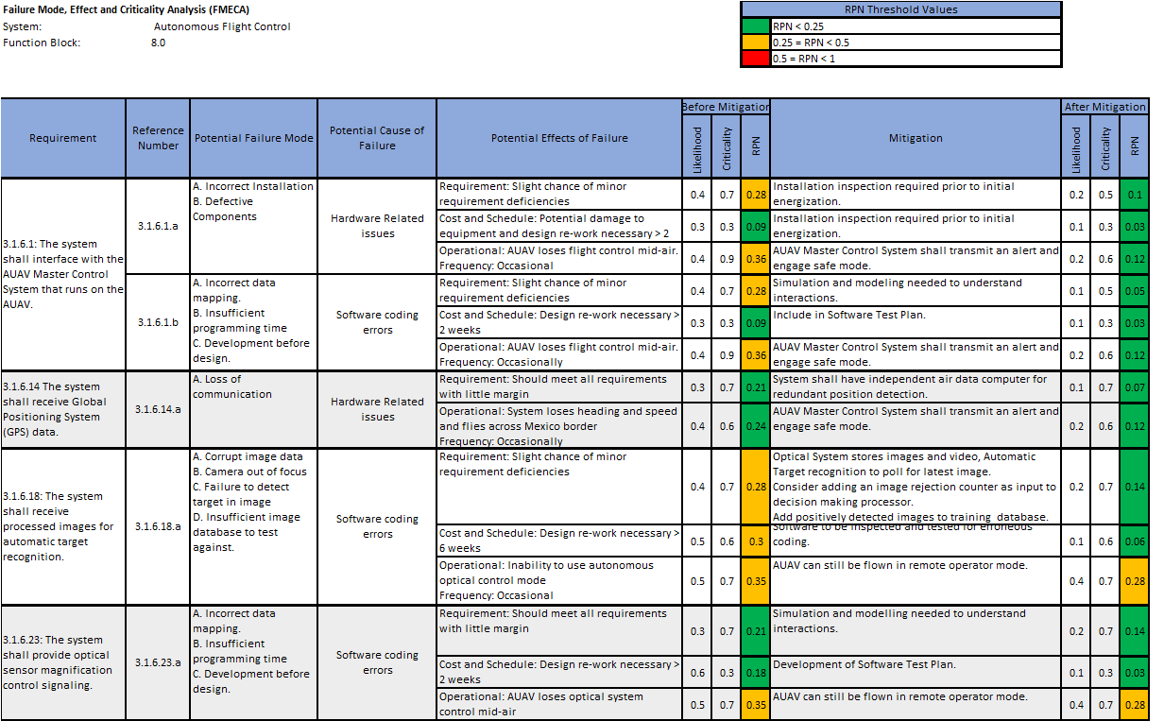
Failure Mode, Effect, and Criticality Analysis (FMECA), cont’d

Slide 40
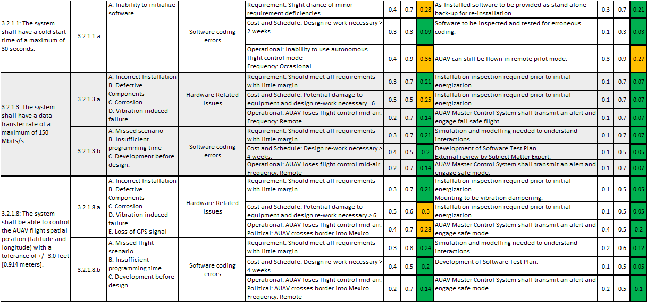
Failure Mode, Effect, and Criticality Analysis (FMECA), cont’d

Slide 41
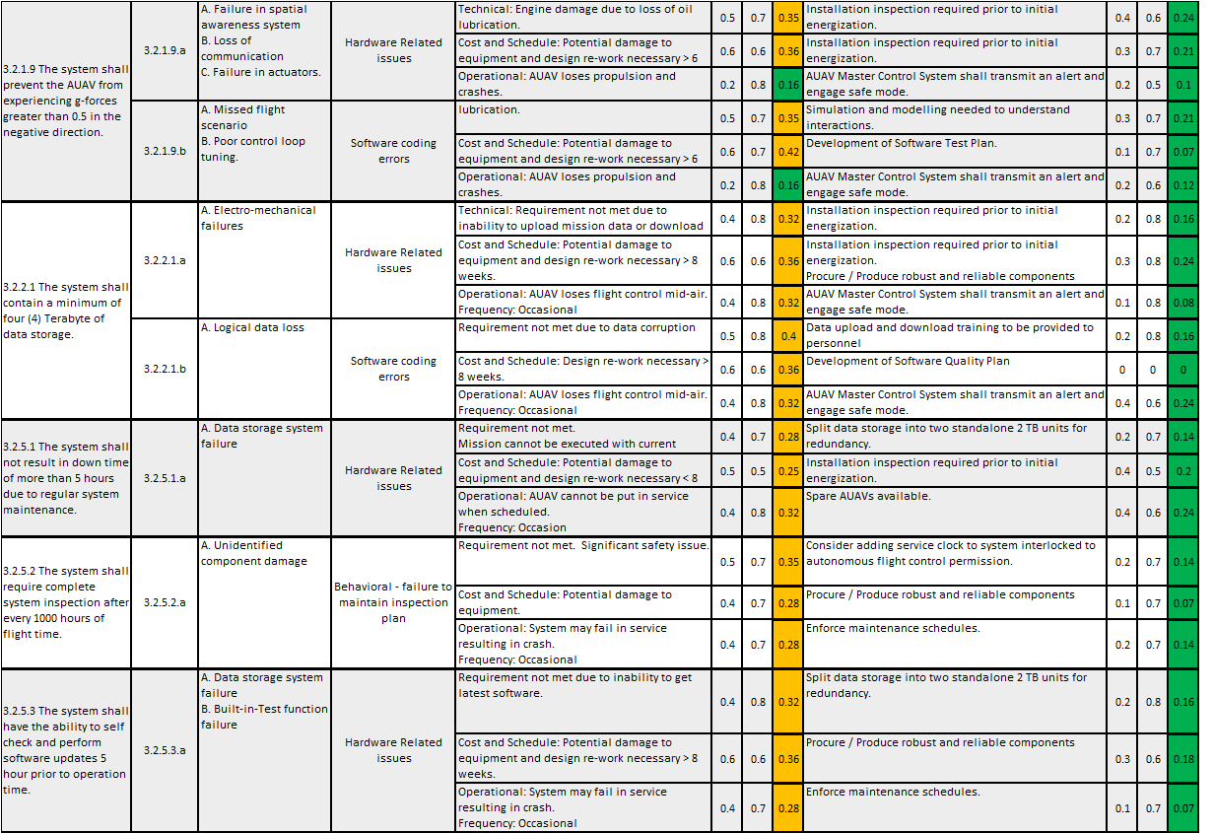
Failure Mode, Effect, and Criticality Analysis (FMECA), cont’d

Slide 42
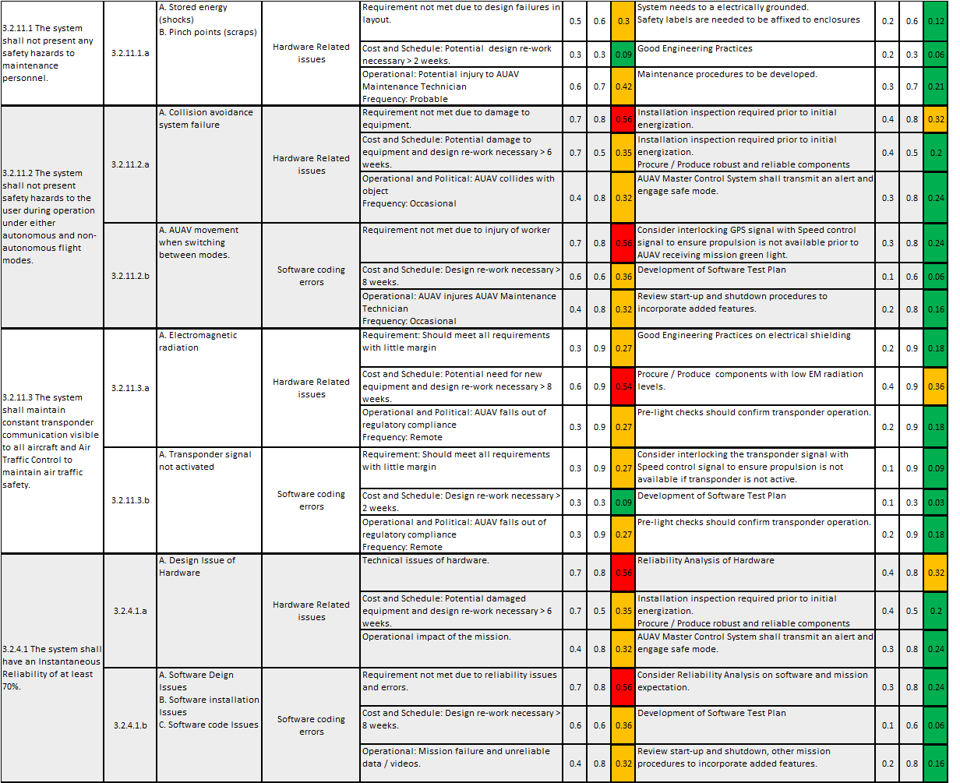
Failure Mode, Effect, and Criticality Analysis (FMECA), cont’d

Slide 43
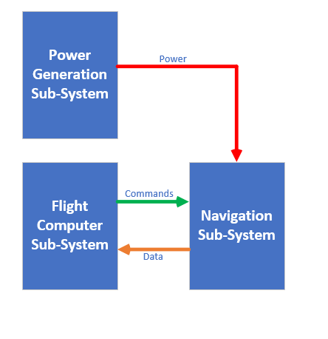
Functional Block Interface Identification
The navigation sub-system interfaces with the power generation sub-system to receive power. It also interfaces with the flight computer sub-system to receive commands and send data. These interfaces are shown in the diagram below:

Slide 44
Testing Plan/Protocol
System testing and evaluation shall be conducted during each phase of the system life cycle. The system shall be tested in a tiered approach, verifying each of the system requirement of the system requirements described in Section 3, while also validating the functionality of the system. The following levels and types of testing shall be performed:
Analytical and Simulation Evaluation: This involves evaluation and analysis of computer simulations for various system components.
Type 1 Testing: Evaluation of initial models and development builds for the component software. Testing shall be performed at the Supplier’s facilities using Supplier’s test tools and resources.
Type 2 Testing: Evaluation of the system prototype and initial integration of the system components. Testing shall be performed at the Supplier’s facilities using the Supplier’s test tools and resources.
Type 3 Testing: Evaluation of the final implementation of the system. Testing shall be conducted at the Supplier’s facilities and Client’s base of operations using the Supplier’s test tools and resources.
A formal software test plan and test report will be submitted at critical design review
Tests will be evaluated based on the four modes of requirement verification
Inspection
Demonstration
Test
Analysis

Slide 45
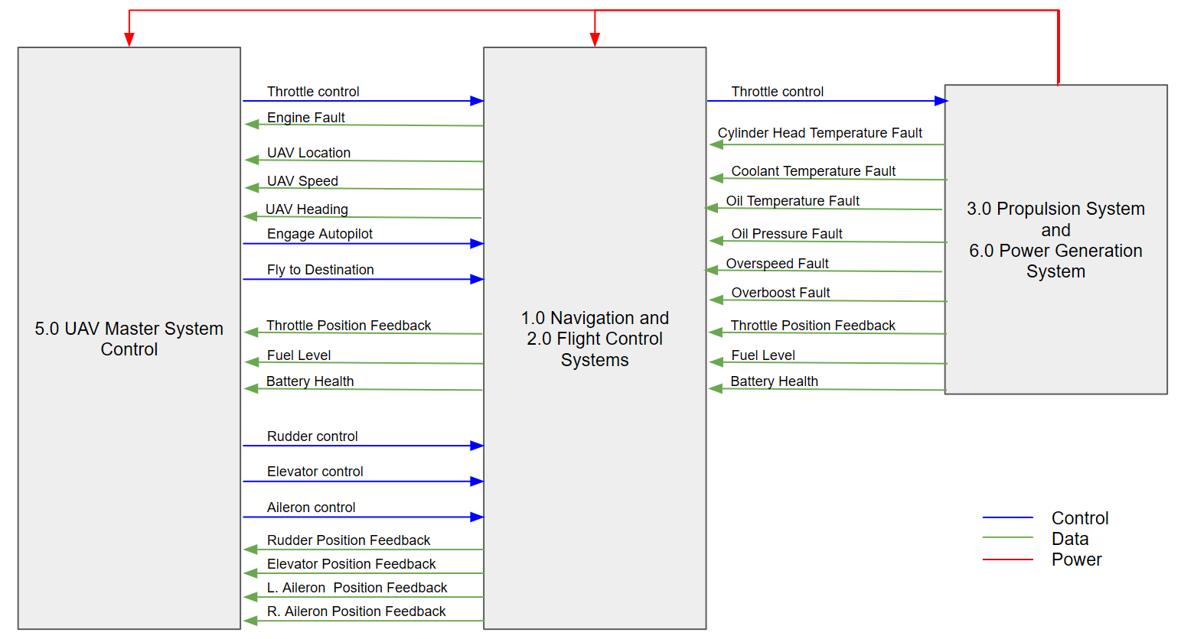
Existing Navigation & Flight Control Systems
Function Blocks 1.0 & 2.0
Notes:
The navigation and flight control system provides the UAV flight officer remote piloting capabilities. Specifically, it controls the speed, pitch, roll and yaw of the UAV by manipulating the engine throttle (via the propulsion system), elevator, ailerons, and rudder settings, respectively. As well as the deployment and retraction of the landing gear.
Feedback of position to the UAV Flight Officer is provided by existing position sensors on the elevator, ailerons and rudder.
The current UAV has a rudimentary autopilot system installed utilizing Global Positioning System and an inertial navigation system. This system is used to allow the UAV to fly from waypoint to waypoint once at cruising altitude. It uses the GPS to detect its current position when the autopilot is activated and then uses feedback from the inertial navigation system to monitor its position relative to that GPS point.
The Global Positioning System is connected to the existing flight computer, which can then transmit its position and speed to the Mission Control Center.

Slide 46
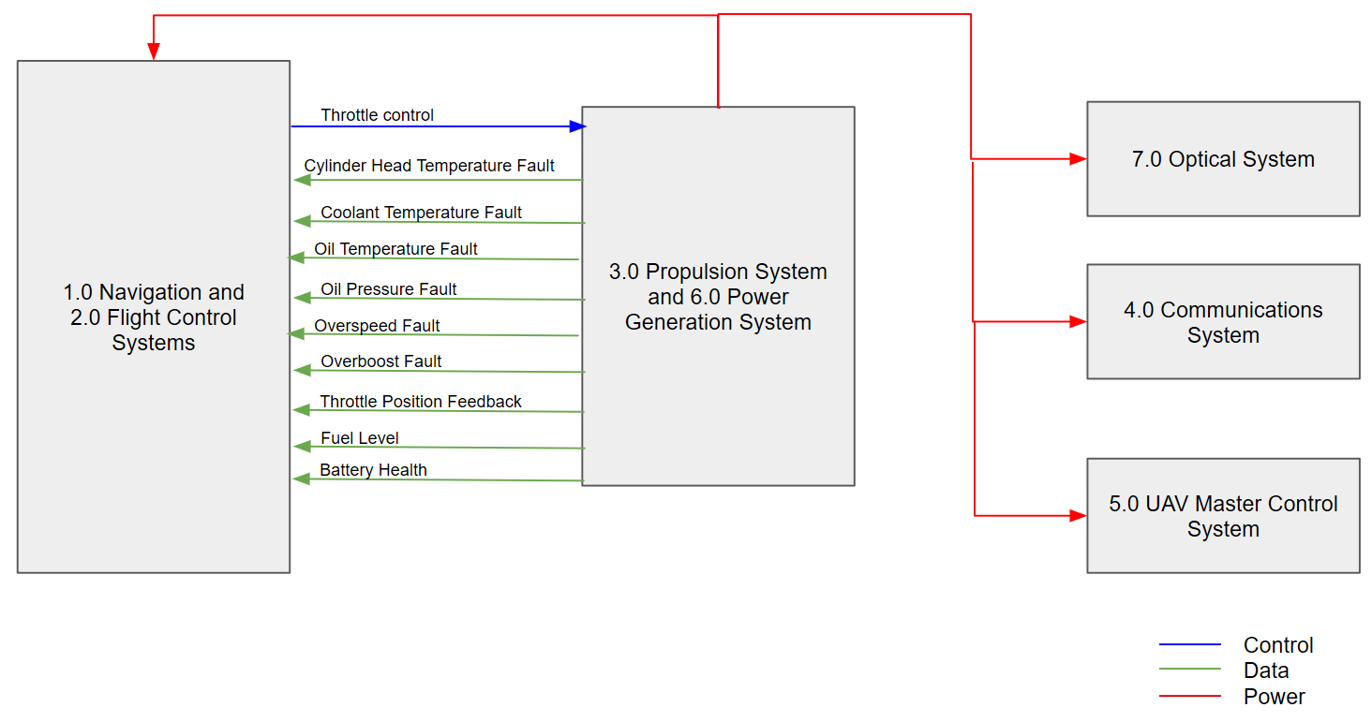
Existing Propulsion and Power Systems
Function Blocks 3.0 & 6.0
Notes:
Propulsion of the UAV is provided by a Rotax 914-F-2 engine.
The 914 designates it as a 4 stroke, 4-cylinder horizontally opposed, spark ignition engine with turbocharger.
The system monitoring sensors are currently wired into the existing flight computer for communication back to the Mission Control Center and the speed control is an input from the UAV Flight Operator into the Turbocharge Control Unit (TCU) via the existing Flight Computer.
The UAV also is provided with visual indications of instrumentation status to the UAV Technician for manual start-up and shutdown operations.
Power is generated from an external alternator with a rectifier-regulator at 12 Volts direct-current (VDC) and 40 Amperes.

Slide 47
Existing Communication System
Function Blocks 4.0
The communication system provides the data link between the Mission Control Center and the UAV. The system includes the equipment and data processing to send and receive data to and from the Mission Control Center.
The AUAV is equipped with Ku-band and C-band capabilities.
As this Function Block is only used to transmit data from the UAV Master Control System and the Ground Master Control System inputs and outputs are as depicted for Function Block 5.0 UAV Master Control System.
Notes:
The communication system provides the data link between the Mission Control Center and the UAV. The system includes the equipment and data processing to send and receive data to and from the Mission Control Center.
The UAV is equipped with Ku-band and C-band capabilities.
As this Function Block is only used to transmit data from the UAV Master Control System and the Ground Master Control System inputs and outputs are as depicted for Function Block 5.0 UAV Master Control System.

Slide 48
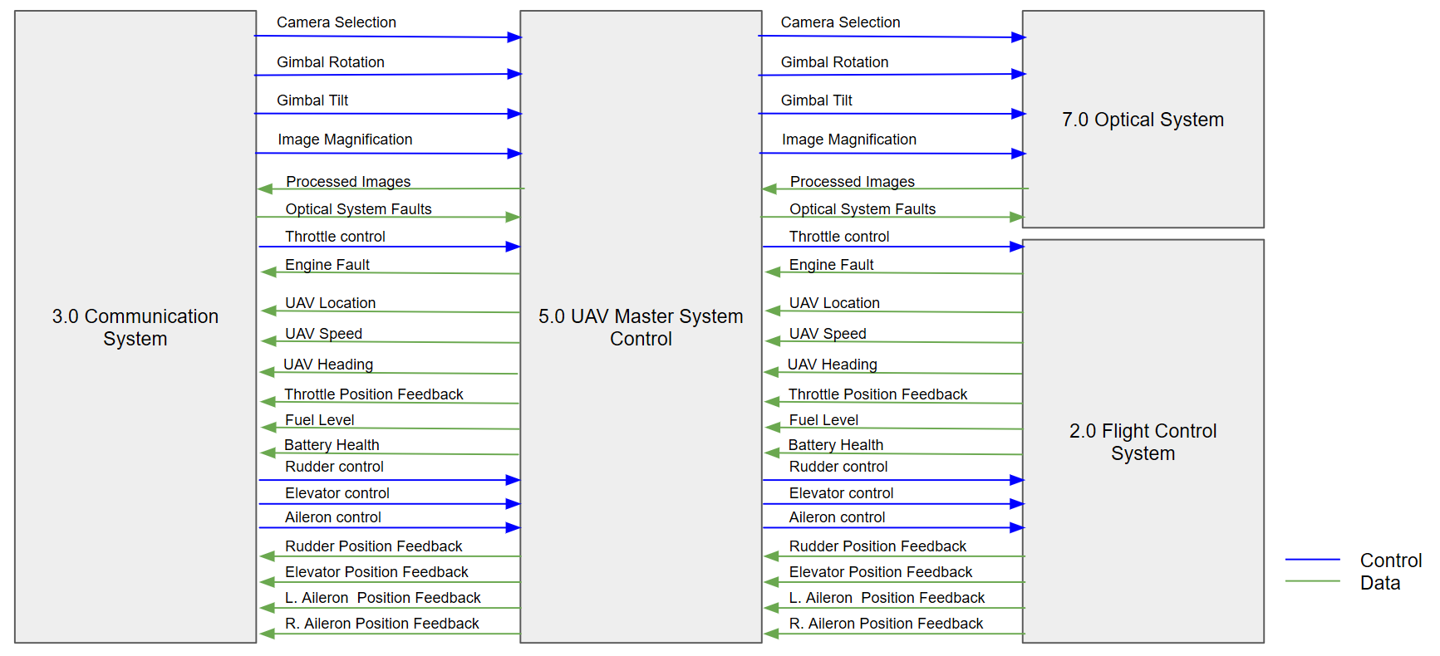
Existing Master System Control
Function Blocks 4.0
Notes:
The UAV Master Control System was supplied by General Atomic and provides the processors to consolidate and extract the data passed to and from the Mission Control Center to the UAV through the communication link.
All control and data signals must pass through the UAV Master Control System.

Slide 49
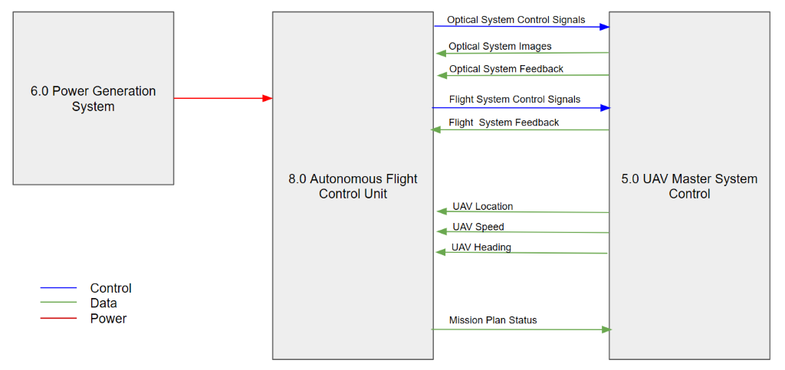
Existing Autonomous Flight Control Sub-System
Function Blocks 8.0
Notes:
This system consists of electro-optical and infrared cameras.. The purpose of this system is to capture high quality images and video and forward them on to the Mission Control Center through the appropriate communication method.
The two-colour Day-light television (DLTV) is equipped with variable zoom and 955mm Spotter, while the high resolution Forward Looking InfraRed (FLIR) has six fields of view ranging from 19mm to 560 mm.
The gimbal provides directional control and image stability, as well as real time image enhancement for Electro-Optical day, Electro-Optical night, and Infrared. It also provides automatic image focus capabilities.
In the current system, communications from the UAV Optical Operator are sent to the gimbal controller where it targets the specified location and then captures the images to return back to the UAV Optic Operator.

